Slide 1
Ages and Stages (toddlers 1-3years)
Jessica Stubblefield

Slide 2
A toddler is very active: 18 months, they go down stairs backwards on their hands and knees, and roll objects on the floor. 2years, turn handles on doors, and push chairs in position to obtain objects out of reach. 3years, throwing objects over hand, and go down stairs by alternating their feet. When a toddler is in play they look out of balance. Ex: running their legs go out to the side. Jumping they’re all over the place. It’s the growth of their Gross motor muscles/ and fine motor muscles.
Physical:

Slide 3
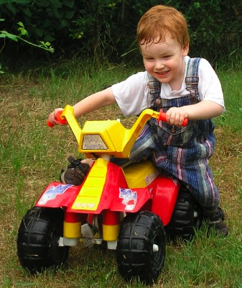
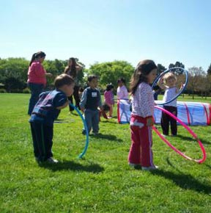
Physical:

Slide 4
Emotional:
When it comes to their emotions toddlers act out, for the most part there are
blunt.
Toddlers show their emotions by; body language face expression.
Enjoyment/Joy - lips wide and out, smiling
Interest/Excitement - eyebrows down, eyes tracking, eyes looking, closer listening
Surprise/Startle - eyebrows up, eyes blinking
Anger/Rage - a clenched jaw, frowning, a red face
Disgust - head forward and down, the lower lip raised and protruded
Dis-smell (reaction to bad smell) - upper lip raised, head pulled back
Distress/Anguish - crying, sobbing, mouth lowered, arched eyebrows
Fear/Terror - frozen stare, pale face, sweat, coldness, erect hair
Shame/Humiliation - the head down and averted, blushing, eyes lowered

Slide 5
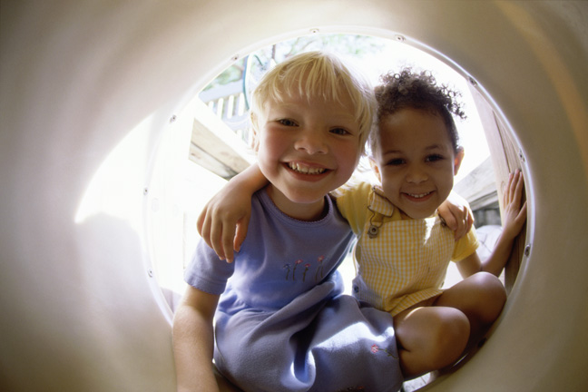
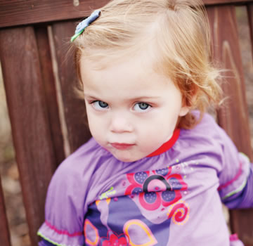
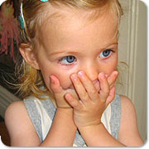
Emotions:

Slide 6
Social:
1year olds; have temper tantrums when they need to share toys.
2year olds; their play is short but they don’t like to share, and they like to take up on house hold task.
3year olds; this is when they start to get all in people business and wont stop talking, and their very social they like to share their things.
When toddlers play with other children their age, they sometimes are parrell
Or cooraptive .
When a child is Parrell , that’s when they are sitting next to each other and don’t say anything to each other.
When a child is cooraptive, that’s when the children inter act with each other..

Slide 7
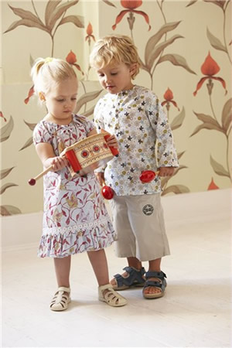
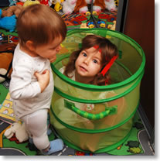
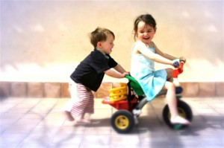
Social:

Slide 8
Cognitive:
Everyday a toddler's mind is filled with new information.
They try out, and learn from, cause and effect experiments.
Toddlers are mimic boxes , they do what ever they see their piers doing.
When toddlers talk their speech isn’t the best. You can barely understand them .
Well everyone is raised different, so it all depends on your heritage wit your language. But the younger the kid is as in; 1year olds they are barely starting to say momma and dada, 2year olds they start to say “no,” and 3year olds start to have full conversations and their language sounds like a blur to most people.

Slide 9
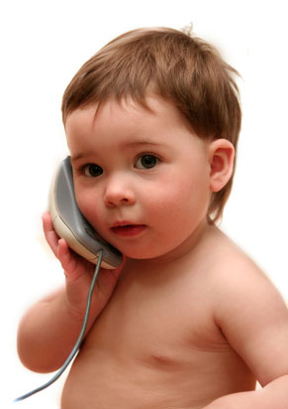
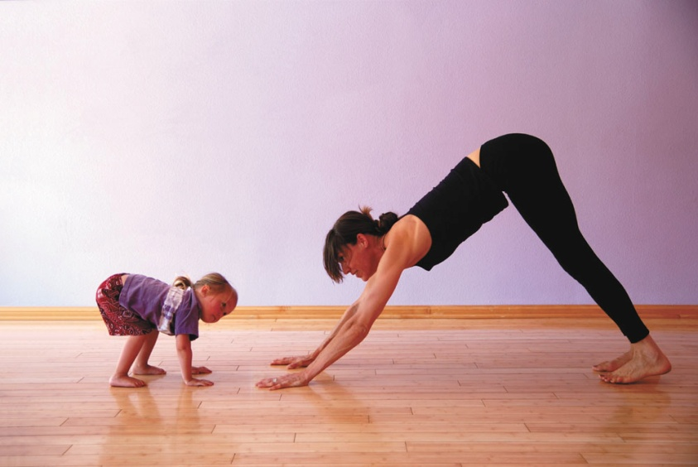
Cognitive:

Slide 10
References:
http://illinoisearlylearning.org/tipsheets/fitness.htm
http://www.kidsdevelopment.co.uk/UnderstandingBabiesEmotions.html
http://urbanext.illinois.edu/babysitting/age-toddler.html
http://www.google.com/

